Slide 1
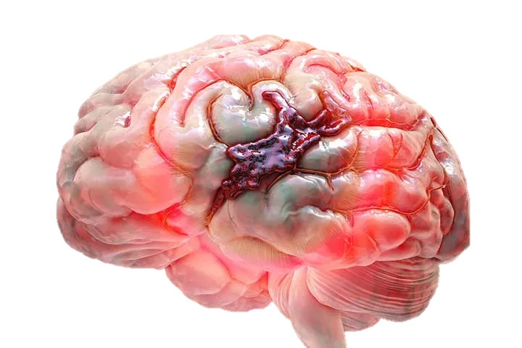
TOPIC: STROKE PATIENT HEALTHCARE
Presented By: Sanjibita Mishra

Slide 2
Contents
Introduction & Problem Statement
Importing libraries
Data Understanding
Data Cleaning
Data Visualization
Model Selection
Model Comparison
Conclusion

Slide 3
Introduction
According to the World Health Organization (WHO) stroke is the 2nd leading cause of death globally, responsible for approximately 11% of total deaths.
This dataset is used to predict whether a patient is likely to get stroke based on the input parameters like gender, age, various diseases, and smoking status. Each row in the data provides relevant information about the patient.

Slide 4

Problem Statement
The goal of this exploratory analysis is to develop an effective model for predicting the likelihood of strokes in individuals within a healthcare dataset.

Slide 5




IMPORTING LIBRARIES

Slide 6
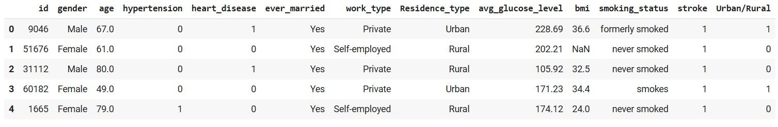
Data understanding
Displaying Dataset
Data Shape
(5110, 12)

Slide 7
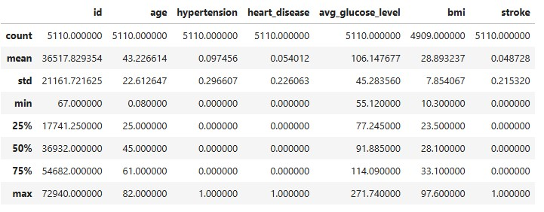
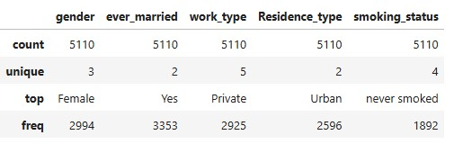
Data understanding
Summary Of Numerical Type Data
Summary Of Categorical Type Data

Slide 8
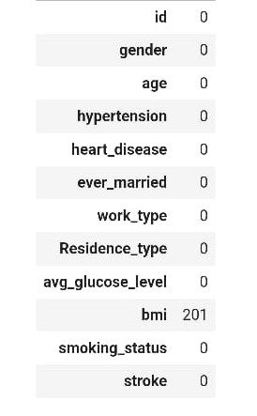
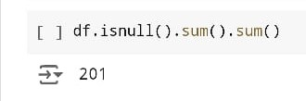
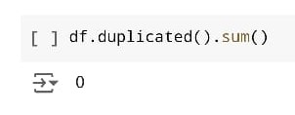
Data CLEANING
After imputation null values
Checking null values
Checking Duplicate Values

Slide 9
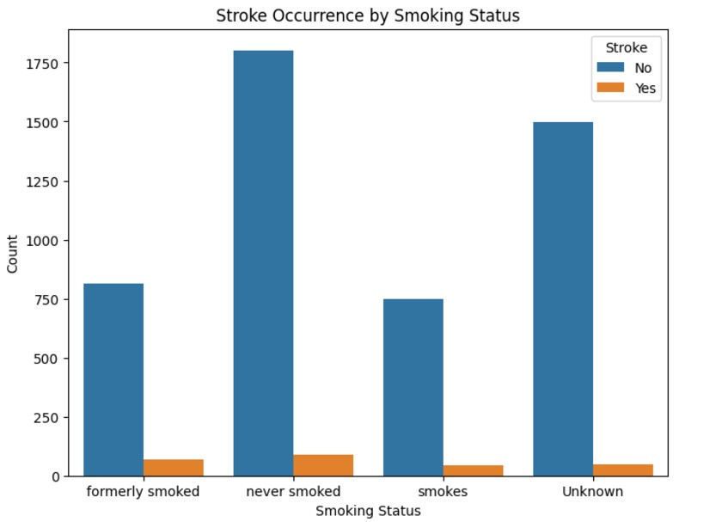
Data visualization
Analysis for Categorical Data
Stroke occurrences are low across all smoking statuses compared to non-strokes.
The "never smoked" group has the highest count, for both stroke and non-stroke cases.
"Unknown" smoking status also shows a high non-stroke count, similar to "never smoked."
"Formerly smoked" and "smokes" categories have lower counts for both outcomes.
Overall, smoking status alone doesn’t appear strongly linked to stroke occurrence in this data.

Slide 10
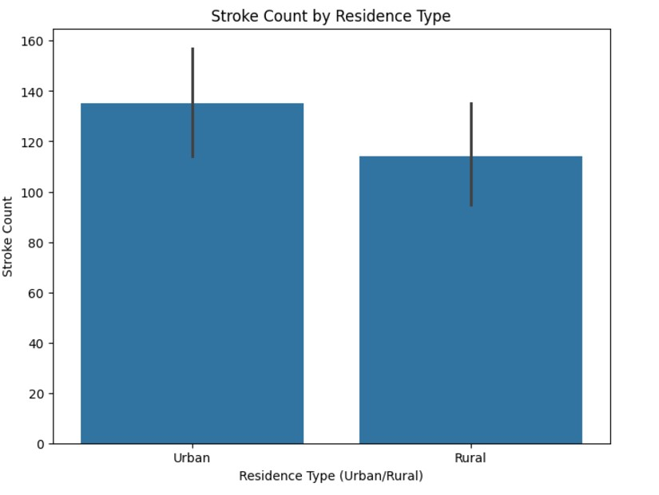
Data visualization
Analysis for Categorical Data
The stroke count is slightly higher in urban areas compared to rural areas.
Both urban and rural areas show relatively similar stroke counts, indicating no strong disparity between residence types.
The error bars suggest some variability in the data, with urban areas having a broader range compared to rural areas.
This distribution implies that residence type (urban or rural) may not be a significant factor influencing stroke occurrence.

Slide 11
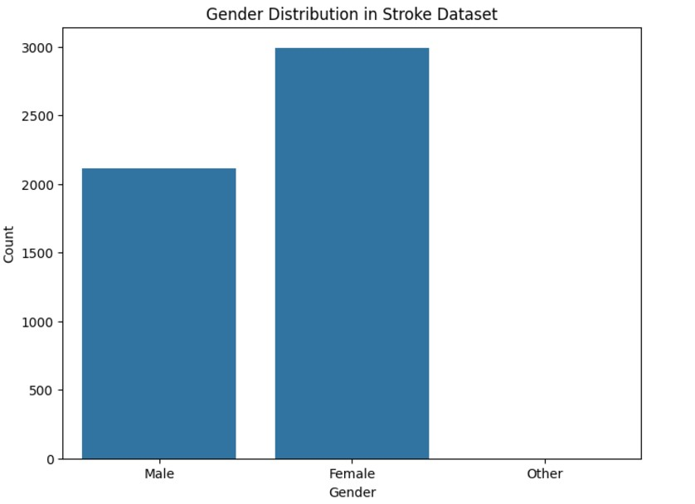
Data visualization
Analysis for Categorical Data
The distribution of genders in the dataset is ad follows:
Female: 2,994 individuals
Male: 2,115 individuals
Other: 1 individual
The dataset is predominantly composed of female and male entries, with a minimal representation from the "Other" category.

Slide 12
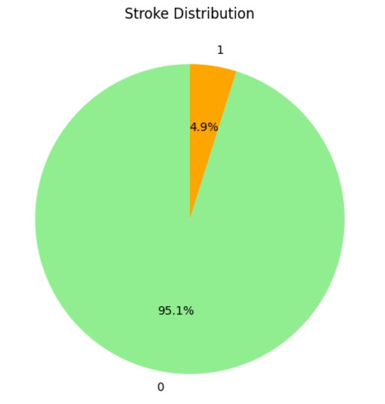
Data visualization
Analysis for Categorical Data
95.1% of the individuals did not experience a stroke (labeled as "0"), while 4.9% experienced a stroke (labeled as "1").
This distribution shows that stroke occurrences are relatively rare in the dataset, making up a small fraction of the total population.

Slide 13
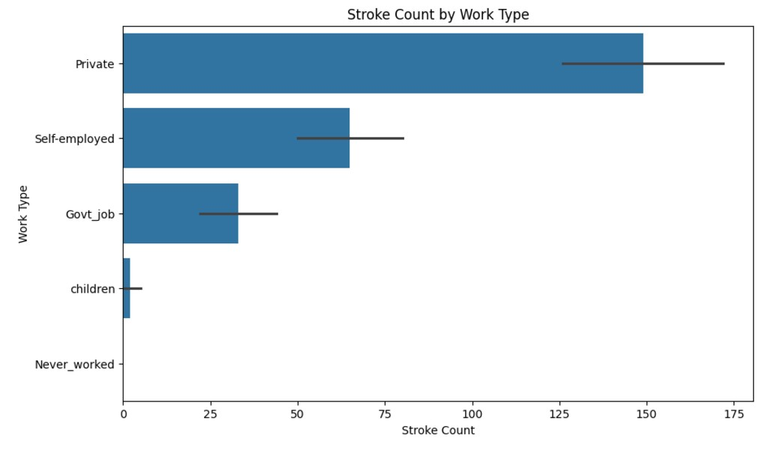
Data visualization
Analysis for Categorical Data
Self-employed individuals have the highest stroke count among all work types.
Those working in Private and Government jobs show a lower stroke count compared to self-employed individuals but higher than children or individuals who never worked.
Children and individuals who have never worked exhibit the lowest stroke counts.
The data suggests a possible correlation between employment type and stroke occurrence, with self-employment associated with a higher stroke count.

Slide 14
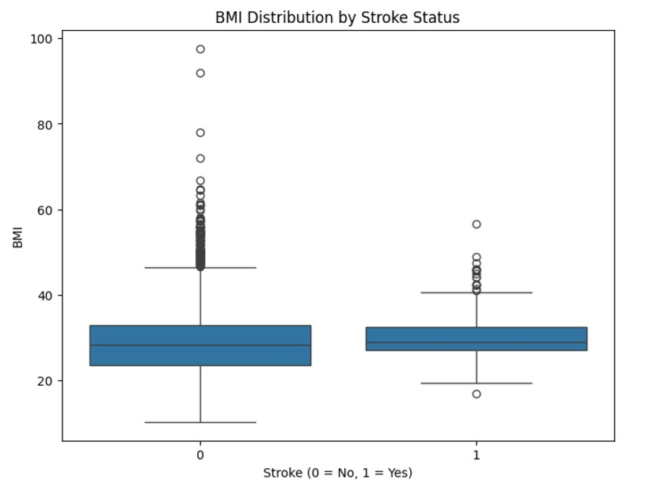
Data visualization
Analysis for Binary Number Data
BMI distributions are similar for both groups (stroke = 0 and stroke = 1), with median BMI values close to each other.
There is a slightly wider range of BMI values for individuals without a stroke (stroke = 0) compared to those with a stroke.
Both groups have outliers at high BMI levels, but the non-stroke group (0) shows more frequent extreme outliers above 40.
Overall, BMI does not show a clear distinction between stroke and non-stroke cases, as the distributions overlap considerably.

Slide 15
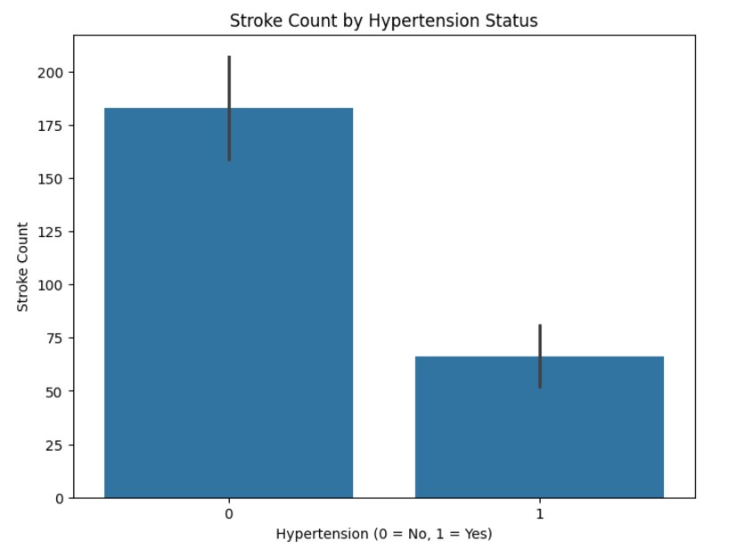
Data visualization
Analysis for Binary Number Data
Individuals without hypertension (0) have a significantly higher stroke count compared to those with hypertension (1).
Although hypertension is a known risk factor for stroke, the count of strokes among those without hypertension is notably larger, which may indicate other contributing factors in these cases.
This distribution suggests that while hypertension is associated with stroke, strokes can also frequently occur in individuals without hypertension, emphasizing the need to consider additional risk factors.

Slide 16
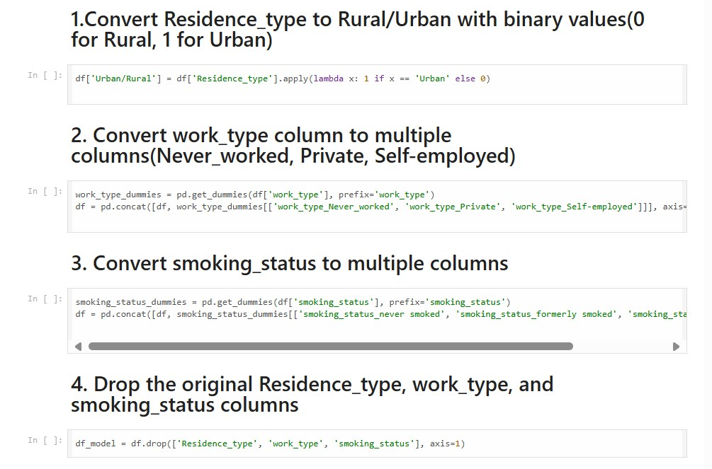
Data ENCODING

Slide 17
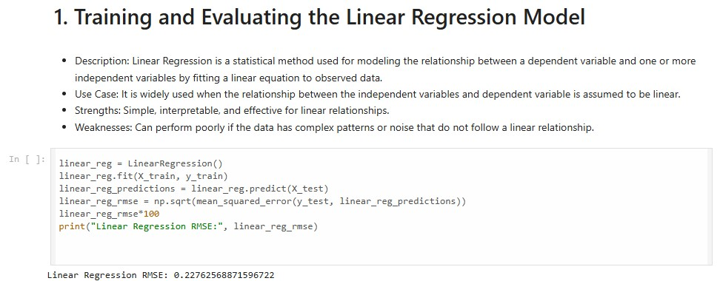
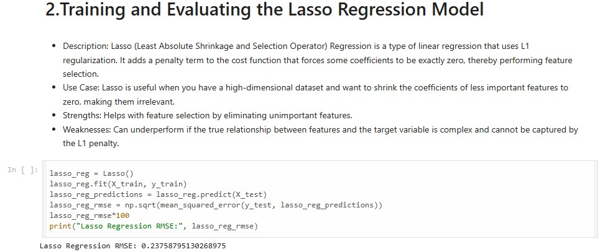
MODEL BUILDING

Slide 18
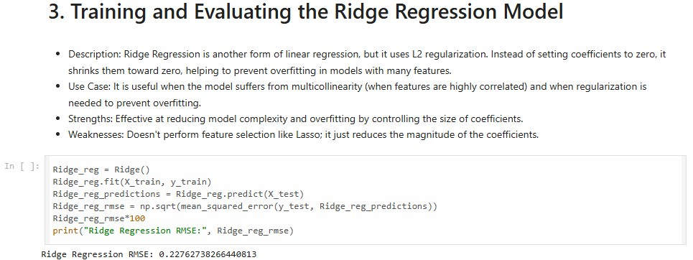
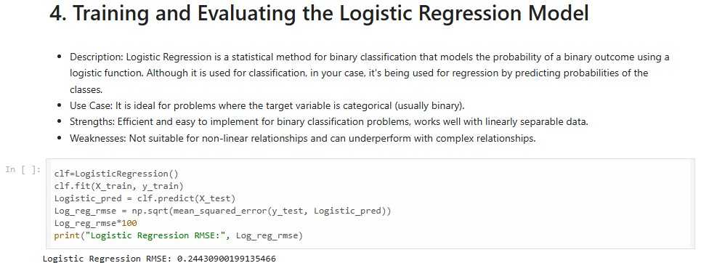
MODEL BUILDING

Slide 19
Comparison of M.L. WITH DEEP LEARNING MODEL
Data: Deep learning requires more data than machine learning.
Training Time: Deep learning takes longer to train than machine learning.
Human Intervention: Deep learning requires less human intervention than machine learning.
Problem Type: Machine learning is best for well-defined tasks with structured data, while deep learning is best for complex tasks with unstructured data.
Learning Method: Machine learning uses simpler methods like decision trees or linear regression, while deep learning uses artificial neural networks.
Computational Power: Deep learning requires more computational power than machine learning.
Feature Engineering: Machine learning requires feature engineering, which is the process of selecting relevant features for a model's input parameters. Deep learning doesn't require explicit feature engineering because the neural network architecture learns features from the data.
Accuracy: Deep learning has higher accuracy than machine learning.
Correlations: Deep learning makes non-linear, complex correlations, while machine learning makes simple, linear correlations.

Slide 20
CONCLUSION
Our project showcases the transformative potential of deep learning in stroke patient healthcare, improving patient outcomes, enhancing clinical decision-making, and reducing healthcare costs. By addressing existing limitations and exploring future research directions, we can further harness this technology to revolutionize healthcare delivery, ultimately saving lives and enhancing the quality of life for stroke patients.

Slide 21
THANK YOU !

